Slide 1

MEDICINAL PLANT Recognition Using Deep Learning and Real-Time Camera Feed

Slide 2
INTRODUCTION
A web-based system that identifies plant species using a live webcam feed.
Integrates a pre-trained deep learning model to classify plants like Aloe Vera, Neem, Tulsi, and Nagfani etc
The app streams real-time video, overlays predictions, and updates dynamically.

Slide 3
Background of the Project
Problem Statement:
Manual plant species identification is time-consuming and error-prone.
Need for a real-time, user-friendly, automated solution using computer vision.
Data:
Collected and preprocessed image data for 40 plant species.
The dataset is used for training machine learning models to classify medicinal plant species based on their images
DOI or URL: https://data.mendeley.com/datasets/748f8jkphb/3
.

Slide 4
DATA PREPROCESSING
Reading an image from the given file path using cv2.imread(img_path)
Since OpenCV loads images in BGR format, cv2.cvtColor(image, cv2.COLOR_BGR2RGB) converts it to RGB for compatibility with deep learning models.
The image is then resized to IMAGE_SIZE (e.g., 224x224) using cv2.resize(), ensuring a fixed input size for neural networks.
Scaling down the pixel values from 0-225 to 0-1, making the data easier for the model to process and learn

Slide 5
MODEL DEVELOPMENT
Base Model (MobileNetV2): Pre-trained CNN model without top classification layers, used to extract meaningful features from images.
Pooling Layer: Global average pooling summarizes extracted features into a single feature vector.
Freezing Layers: The MobileNetV2 base layers are frozen, keeping learned features stable during training.
Dense Layer (128 units): Adds a dense layer with 128 neurons and ReLU activation to further process extracted features.
Output Layer (40 units): Final dense layer with softmax activation classifies images into one of 40 categories

Slide 6
MODEL TRAINING
Compiles the model using the Adam optimizer, sparse categorical cross entropy as the loss function for multi-class classification, and accuracy as the evaluation metric
Training the model on train images and trainl abels using a batch size of 36 for 20 epochs, while reserving 20% of the training data for validation to monitor performance

Slide 7
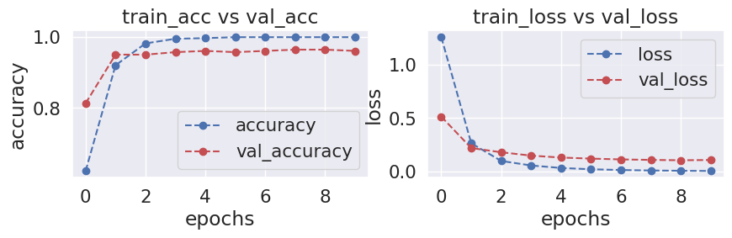
MODEL EVALUATION
The left graph shows a strong increase in training accuracy, indicating the model is effectively learning from the data.
The right graph shows a rapid decrease in training loss and stabilizes, suggesting the model generalizes well without significant overfitting.

Slide 8
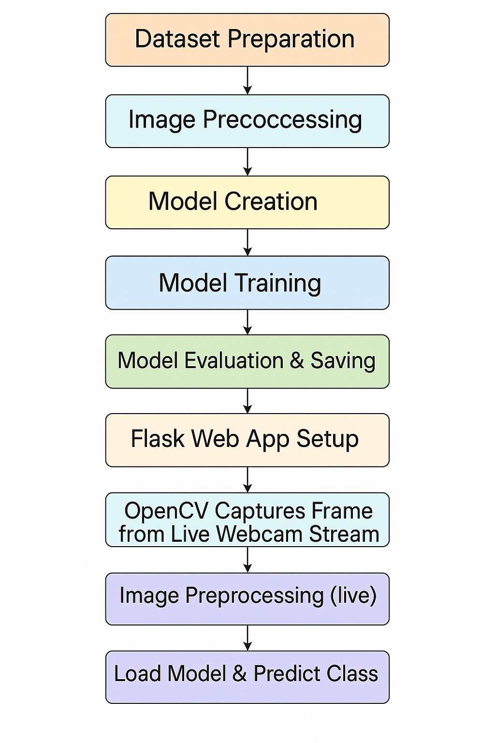
FLOWCHART

Slide 9
System Operation & Findings
System Architecture:
Flask for web framework and TensorFlow/Keras for prediction.
OpenCV used to capture webcam feed, preprocess frames, and overlay results.
Findings:
High accuracy in well-lit, clean backgrounds.
Confidence threshold of 0.6 set to reduce false positives.
Real-time feedback enhances user interaction and displays top prediction and class-wise probabilities

Slide 10
CONCLUSION
Successfully developed a lightweight, real-time plant recognition system.
Effective integration of transfer learning and web technologies.
Can be extended to other plant species or applications like disease detection.

Slide 11
Thank you

